Slide 1
Patti Whitman, Villa Park Resident 14Nov2023
Serving on the Orange County Grand Jury

Slide 2
Grand Jury Recruitment
Now Recruiting for
2024-2025
ocgrandjury.com

Slide 3
Grand Jury Responsibilities
Ensure Orange County, its entities and agencies are being governed honestly, efficiently and in a fiscally sound manner- to name a few:
Agencies
Health Care Agency, Homeless Centers, Animal Care, Social Services etc.
John Wayne Airport
Special Districts
Water, Sanitation, Landfill, etc.
Law Enforcement, Coroner and Jails
Fire Authority
Emergency Communications Bureau (911)

Slide 4
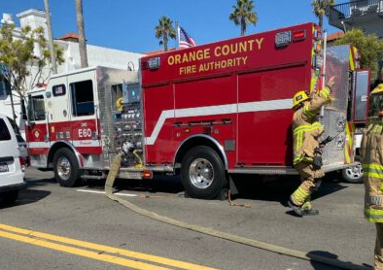
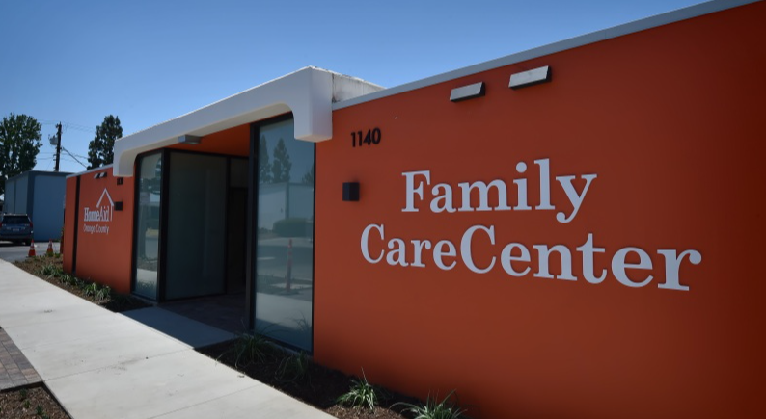
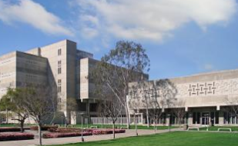
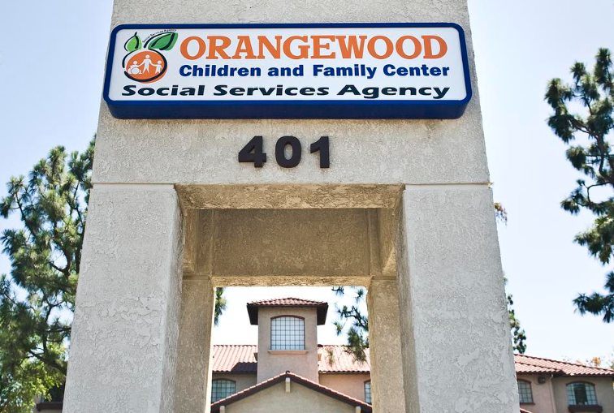

Slide 5
Elected Officials
Sheriff-Coroner
District Attorney
Auditor/Controller
Board of Supervisors
Treasurer/Tax Collector
Assessor
Heads of County Agencies
Health Care Agency
Social Services
Animal Care
Transportation- i.e. JWA
Public Works

Slide 6
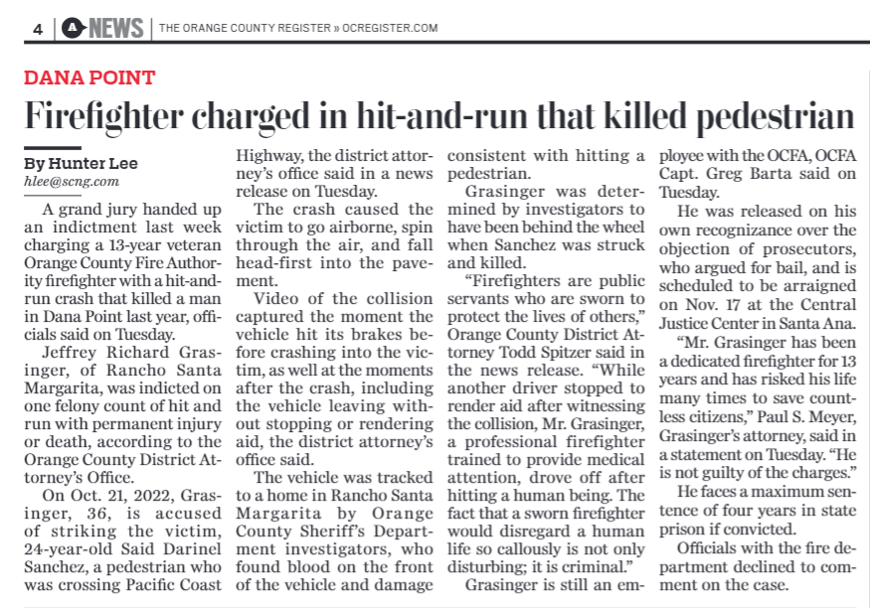
Indictments
Brought to the Grand Jury by the District Attorney
Based on evidence presented, GJ makes recommendations to indict or not indict
Civil
Criminal

Slide 7
Investigations
Rule In, Rule Out any potential wrong-doings
Facility tours
Interviews
Experts
May stem from Public Complaints
May be things we hear about from our neighbors, friends, others
If appropriate, reports will be authored and issued to the public

Slide 8
2022-23
Grand Jury
Reports
ocgrandjury.org

Slide 9
One Year Commitment
Many benefits:
Serve your community; make a difference and make our County of Orange the best place to live
You will make 18 new friends!
Learn all the ins and outs of Orange County’s operations and government
$50.00/day!
Mileage
VIP parking at the Superior Court
THANK YOU!

