Slide 1

ORANGE COUNTY
GRAND JURY
Presented by Grand Jurors’ Assn of Orange County

Slide 2
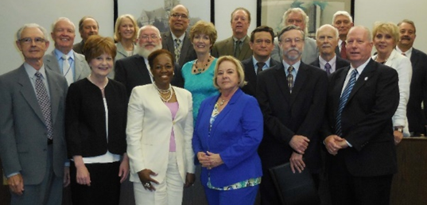
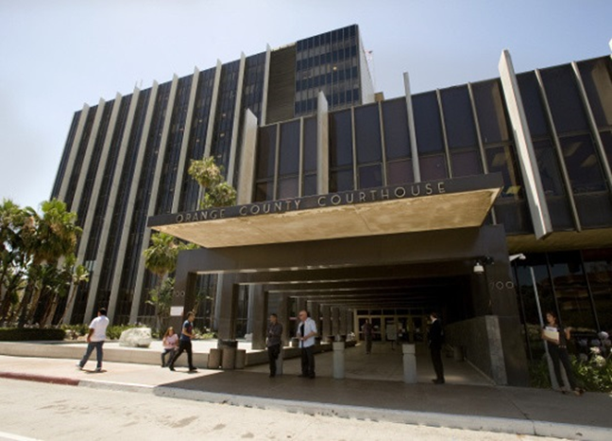
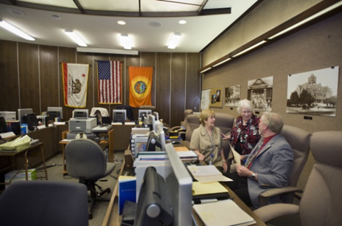
What is the GRAND JURY?
The Orange County Grand Jury is tasked with civil oversight as well as criminal indictments.

Slide 3
Role of the Grand Jury
  Ensure the performance of county, city, and other local agencies is proper and ethical!
  Improve government with their recommendations!
  Respond to citizen complaints about local government agencies!
  Issue indictments for serious crimes!
  Make sure our local tax dollars are wisely spent!
  Evaluate conditions at our county jails!
  P.S. . . . . . NOT Jury Duty

Slide 4
How is the Grand Jury empowered?
CIVIL INVESTIGATIONS
The Grand Jury provides civil oversight of local governments by reviewing and evaluating county and city departments, agencies, special districts, and jails within Orange County.
CRIMINAL INDICTMENTS
The Grand Jury considers evidence for possible indictment of individuals for criminal charges.

Slide 5

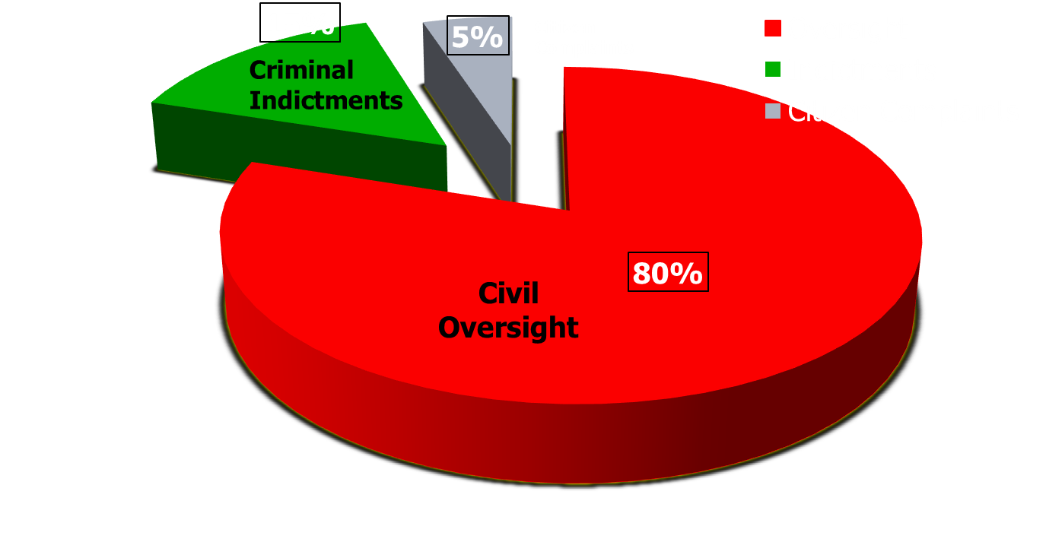
Time Allocation

Slide 6
Criminal Indictment Process
The D.A. presents a case/facts.
Examination of witnesses and evidence.
Grand Jury deliberates:
  Legal standard: “Preponderance of evidence”, not “Beyond a reasonable doubt”.
  Indictment, not conviction.
  D.A. does NOT have to prosecute further.

Slide 7
Criminal Indictments:
DA’s more likely to use the grand jury / indictment process if:
High public interest in the case.
Court calendar is packed.
D.A. wants to “test” the case.
Witnesses are children or minors.
Witnesses are incarcerated in state prison.

Slide 8
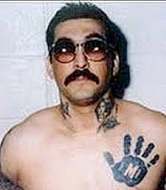

Mexican Mafia killer-turned-snitch could walk free this month
Mexican Mafia boss Rene “Boxer” Enriquez, 52, could be freed later this month, thanks to his work as an informant. He's currently serving two life sentences.
By TONY SAAVEDRA | tsaavedra@scng.com | Orange County Register
PUBLISHED: February 13, 2015 at 8:25 a.m. | UPDATED: July 30, 2018 at 11:31 a.m.

Slide 9

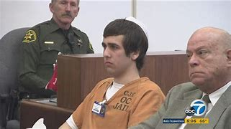

Slide 10

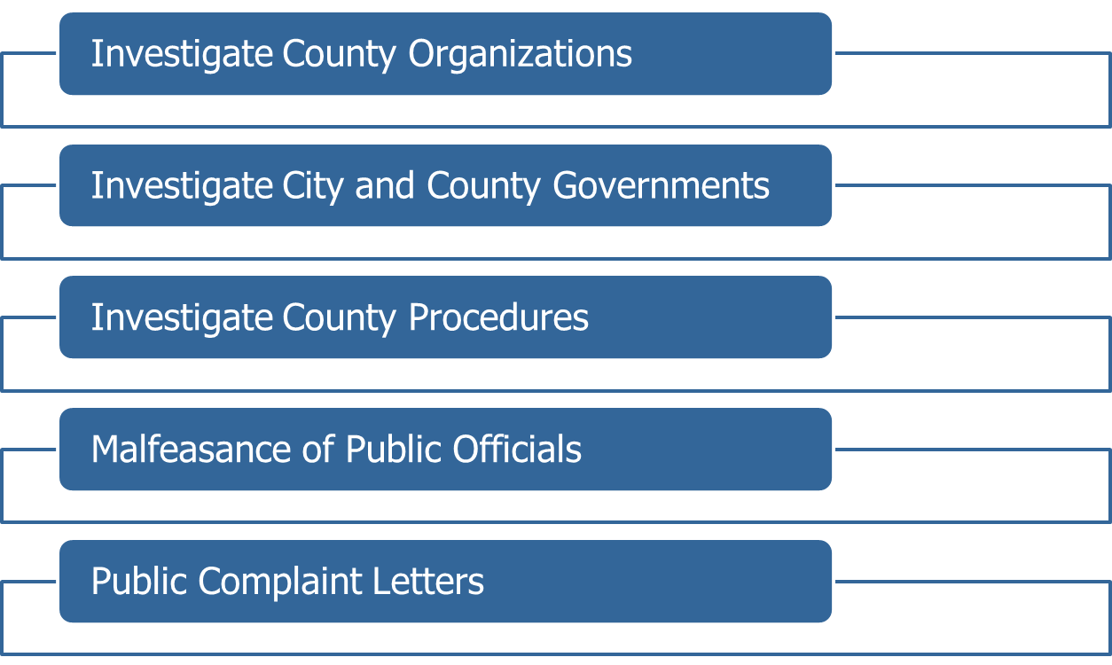

Civil Investigations:

Slide 11









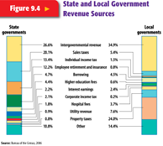


34 cities

Slide 12
Past 5 Years of Reports
Aviation / Airport Irvine “Great Park”
Cannabis Jail / Detention Facilities
County / City Gov Ops Mental Health / Homelessness
Criminal Justice / Sheriff Ops Pandemic
Cybersecurity Pension / Retiree Funds
Economic Development Schools / Education
Environmental Transportation
Ethics / Corruption Vector Control
Fire / Emergency Voting / Elections
GJ Report Follow-ups
*Most reports written * Most recent reports

Slide 13


Investigations and Reports
As a truly independent body, each grand jury is free to choose which governmental entities or public officials to investigate.
Ideas for investigations:
  citizen complaints,
  matters raised by the members of the grand jury,
  referrals from the preceding grand jury,
  whatever is currently “trending”.
While the Grand Jury has no authority to order or otherwise compel compliance, it is through its reports that the grand jury wields its power. Media attention often prompts the changes.

Slide 14
Responses
The California Penal Code provides requirements to respond to the Findings and Recommendations of the Grand Jury report.
  Public agencies must respond within 90 days;
  Officer must respond within 60 days.

Slide 15
Findings
Respondent agrees with Finding;
Respondent disagrees wholly or partially with Finding;

Slide 16
Recommendations
The Recommendation. . . . .
has been implemented;
has not yet been implemented but will be implemented in the future… (with a timeframe).
requires further analysis…(not to exceed 6 months);
will not be implemented because it is not warranted or is not reasonable…(with an explanation therefor).

Slide 17

Grand jury report:
“Orange County animal shelter plagued by deplorable conditions, disease”
https://abc7.com/orange-county-animal-care-ocac-investigations-shelter/795181/

Slide 18
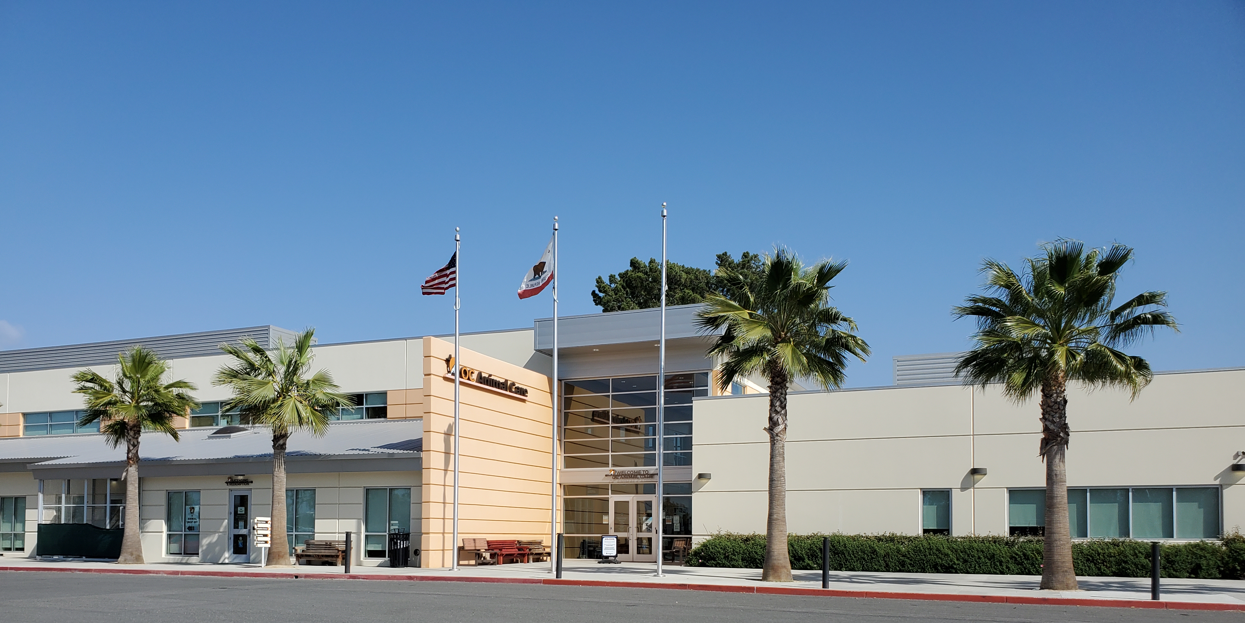
Newly constructed OC Animal Shelter today

Slide 19
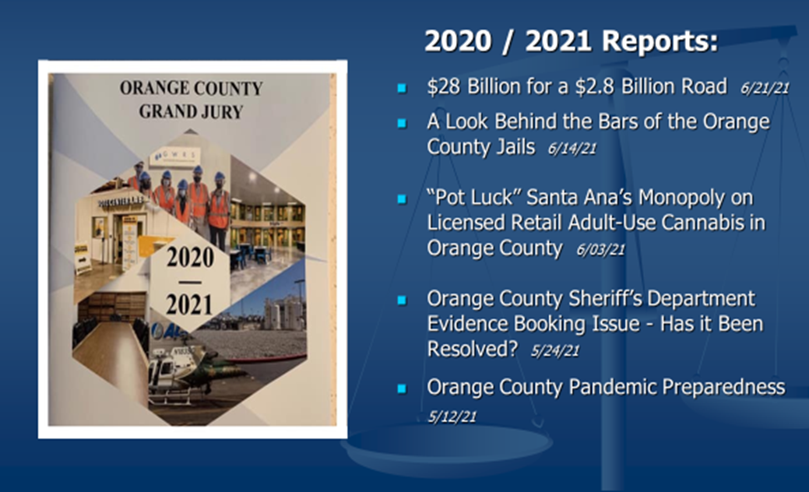
2020 / 2021 Reports

Slide 20


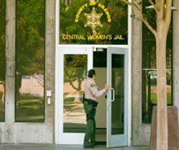

Newspaper Reporting
In Scathing Report, OC Grand Jury Describes Shackles During Birthing, Care Delays in Custody
Orange County Jury Issues Report on County’s pandemic response

Slide 21

Grand Jury Reports
All Grand Jury Reports are in Adobe Acrobat (.pdf) format. Click here to download Acrobat Reader.
Grand Jury Reports and responses (when available) may be viewed at the links below or at the Orange County Public Law Library located in the Civic Center Plaza, building #32.
Expand All / Collapse All
2020-2021 Reports, in order of release.
2019-2020 Reports, in order of release.
2018-2019 Reports, in order of release.
2017-2018 Reports, in order of release.
2016-2017 Reports, in order of release.
2015-2016 Reports, in order of release.
2014-2015 Reports, in order of release.
2013-2014 Reports, in order of release.
2012-2013 Reports, in order of release.
2011-2012 Reports, in order of release.
2010-2011 Reports, in order of release.
2009-2010 Reports, in order of release.
2008-2009 Reports, in order of release.
2007-2008 Reports, in order of release.

Slide 22
2019-2020 Reports, in order of release.
2019-2020 Grand Jury Final Report 07/30/20
Status Update on open 2019-2021 Grand Jury Implementation Items 03/23/21
OC Recycling: Doing it the Right Way 06/30/20
  City of Santa Ana 12/14/20
  City of Irvine 11/24/20
  City of Orange 11/06/20
  City of Brea 11/05/20
  City of Huntington Beach 10/07/20
  City of Buena Park 09/23/20
  City of Dana Point 09/10/20
  City of Anaheim 09/02/20
  City of Anaheim 08/26/20
  County of Orange Executive Officer 08/25/20
  City of Garden Grove 08/25/20
Protecting Those Who Protect and Serve 06/30/20
  City of Seal Beach 01/15/21
  City of Huntington Beach Police Department 12/21/20
  City of Cypress 12/09/20
  City of Irvine 11/24/20
  City of Brea 11/12/20
  City of Placentia 11/12/20
  City of Santa Ana 11/10/20
  City of Orange 11/10/20
  City of Los Alamitos Police 11/09/20
  City of Laguna Beach 11/03/20
  City of Mission Viejo 11/06/20

Slide 23
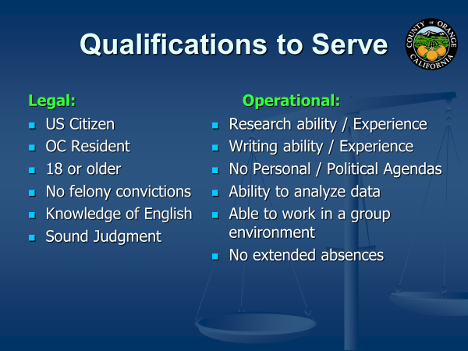

Slide 24

Organization of the Grand Jury
  1 Year Term – July 1 to June 30
  Members:
    Applications rec’d 100 - 200
    Applications vetted 90
    Final Selection 25 – 30 applicants
    Seated 19
    Alternates 11
  Working Hours:
    Mon-Thurs 8:30 – 3:30
    Fridays 8:30 – Noon
  Stipend of $50/day; + Mileage
  Officers:
    Foreperson (selected by Judges)
    Foreperson Pro-Tem
    Secretary
    Assistant Secretary
    Sergeant at Arms
    Historian / Parliamentarian

Slide 25
Committees
Standing Committees
Cities
County Government
Criminal Justice
Environment / Transportation
Health / Human Services
Special Issues / Ethics
Administrative Committees
        Recruitment & Orientation
        Continuity & Editorial

Slide 26

Judge Maria Hernandez
Assistant Presiding Judge

Slide 27




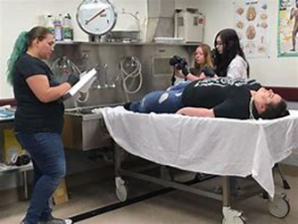

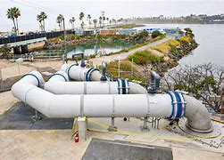
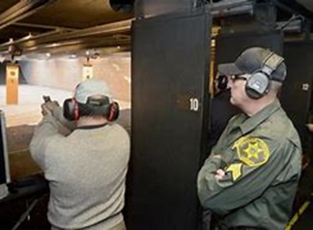


Orange County Tours and Visits
911 Emergency Call Center
OC Water District
Coroner’s
MWD
Shooting Range
JWA Airport
County offices
Court House

Slide 28
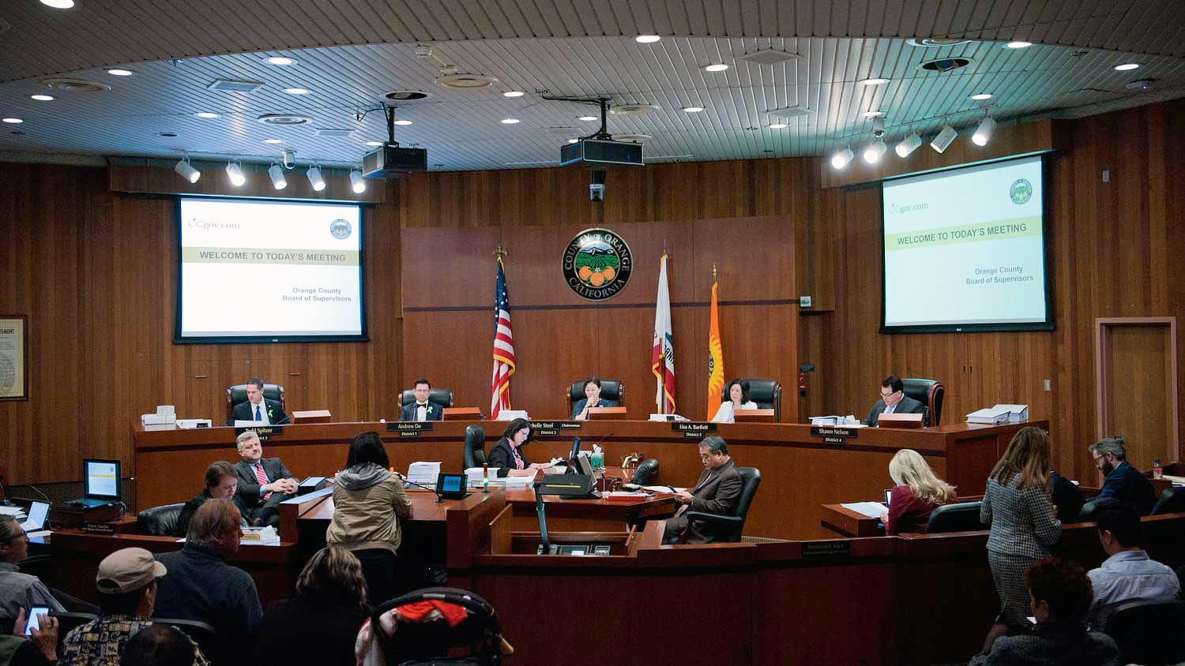

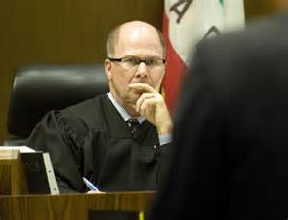
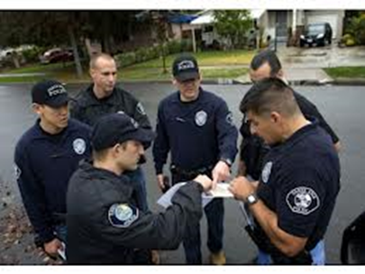
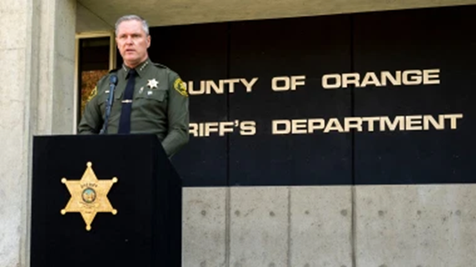
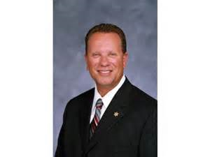

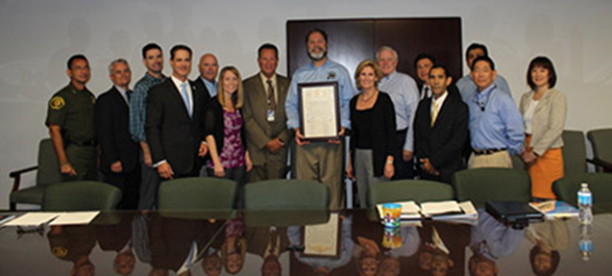

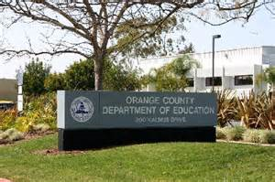

County Departments
Elected Officials & Judges
Board of Supervisors
Sheriff’s Dept.
OC Animal Care
OC Dept. of Education
Health Dept.
Orange County Criminal Justice Coordinating Council

Slide 29

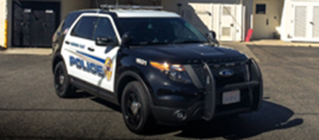
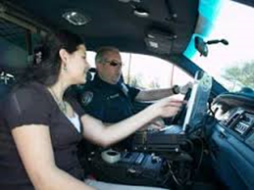
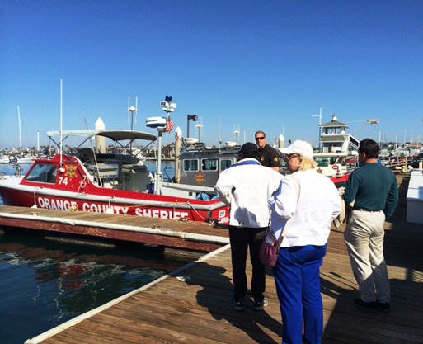
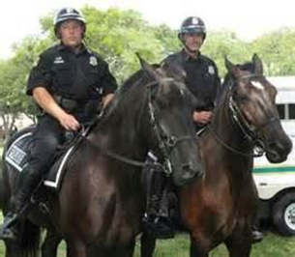
Ride-Alongs with OC Sheriff
(Patrol Car, Harbor Boats, Equestrian, Helicopter)

Slide 30
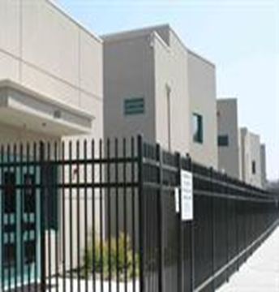
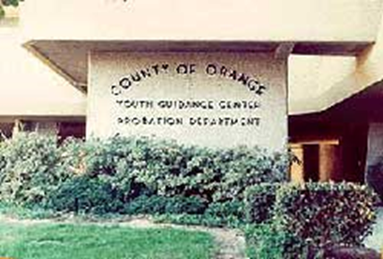
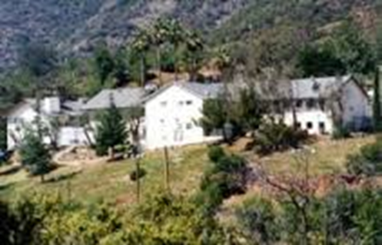

Juvenile Facilities
Youth Leadership Academy
Youth Guidance Center
Juvenile Hall
Joplin Boys Ranch

Slide 31
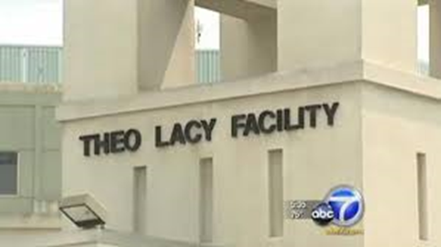
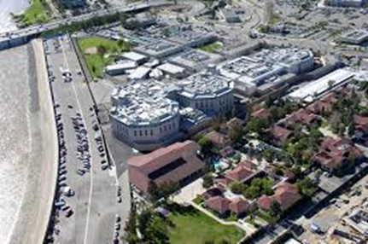


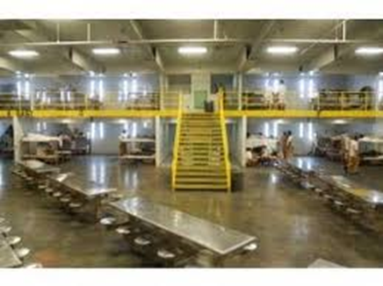
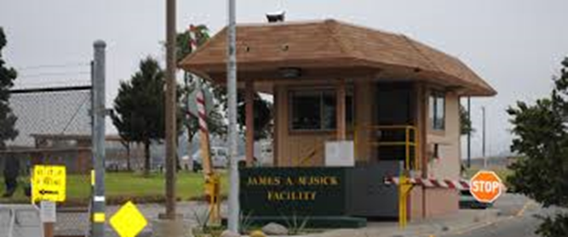
Central Jail, Theo Lacy Jail, Musick Jail

Slide 32
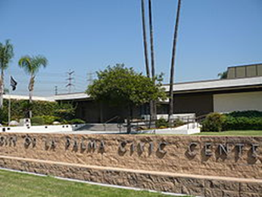

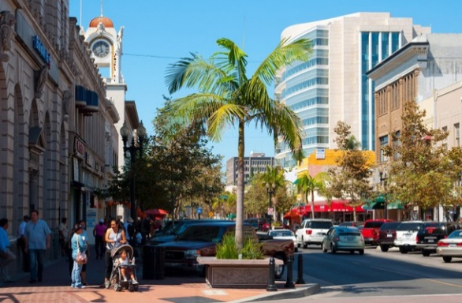

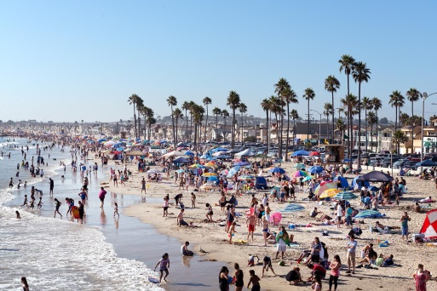
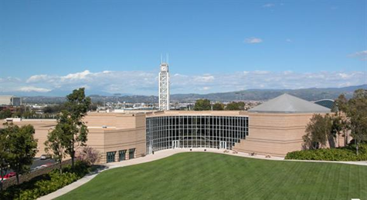
Cities
City Council Meetings
Great Park in Irvine
Downtown Santa Ana
Dana Point Harbor
Huntington Beach
Irvine City Hall

Slide 33
Orange County Grand Jury
QUESTIONS
AND
ANSWERS
www.ocgrandjury.org

