Slide 1

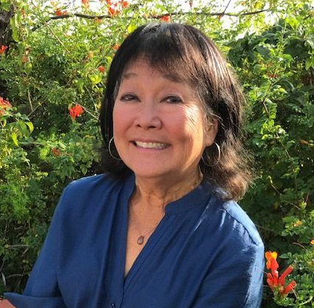

ORANGE COUNTY
GRAND JURY
Presented by
Lynn Bonas & Sandy Dunkin
Grand Jurors’ Assn
of Orange County

Slide 2

Recruitment

Slide 3
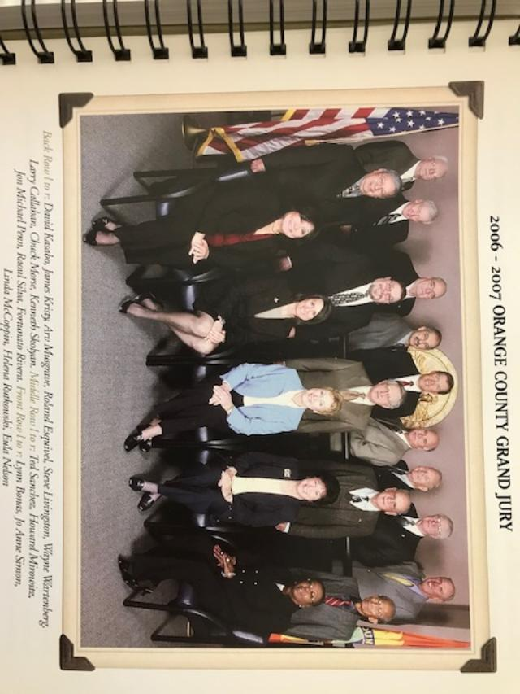
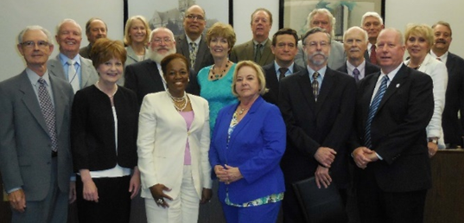
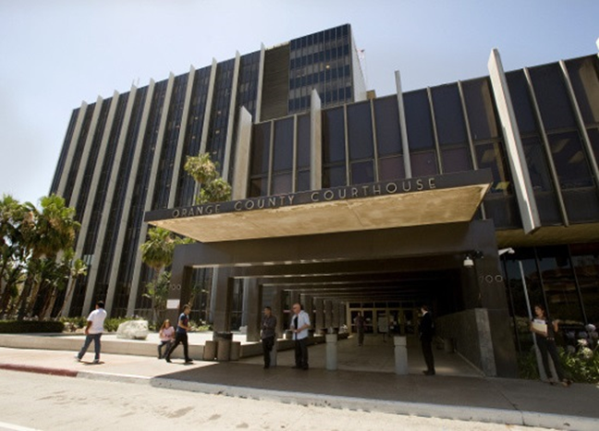
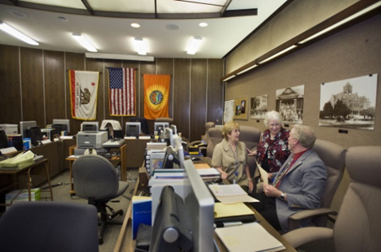
What is the GRAND JURY?
The Orange County Grand Jury is a group of 19 people tasked with civil oversight and criminal indictments. The new Grand Jury is seated in July and works for a full year, concluding the work by publishing reports about their investigations, which are public records and can be read at ocgrandjury.org.
It is said that Grand Juries are the voice of the people and the conscience of the community.

Slide 4
Role of the Grand Jury
  Ensure the performance of county, city, and local agencies is proper and ethical!
  Improve government with their recommendations!
  Respond to citizen complaints!
  Issue indictments for serious crimes!
  Make sure tax dollars are wisely spent!
  Evaluate conditions at our jails!
  P.S. . . . . . NOT Jury Duty

Slide 5
How is the Grand Jury empowered?
CIVIL INVESTIGATIONS
The Grand Jury provides civil oversight of local governments by reviewing and evaluating county and city departments, agencies, special districts, and jails within Orange County.
CRIMINAL INDICTMENTS
The Grand Jury considers evidence for possible indictment of individuals for criminal charges.

Slide 6

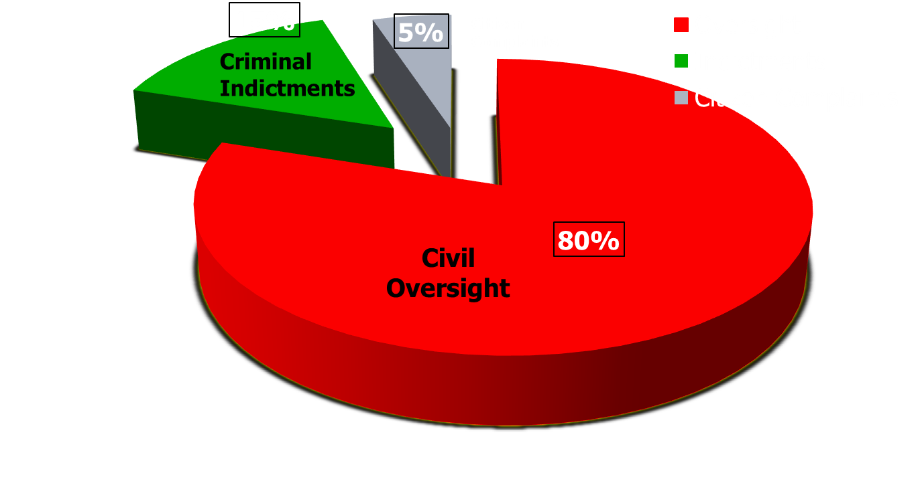
Time Allocation

Slide 7
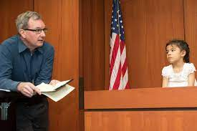

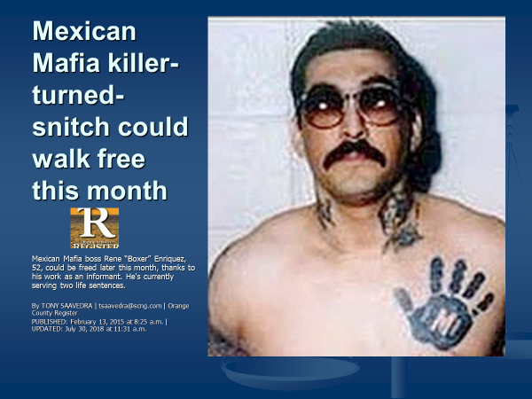
Criminal Indictment Process
The D.A. presents a case/facts.
Examination of witnesses and evidence.
Grand Jury deliberates:
  Legal standard: “Preponderance of evidence”, not “Beyond a reasonable doubt”.
  Indictment, not conviction.

Slide 8










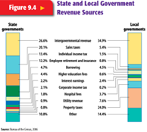

Civil Investigation Process
34 cities

Slide 9
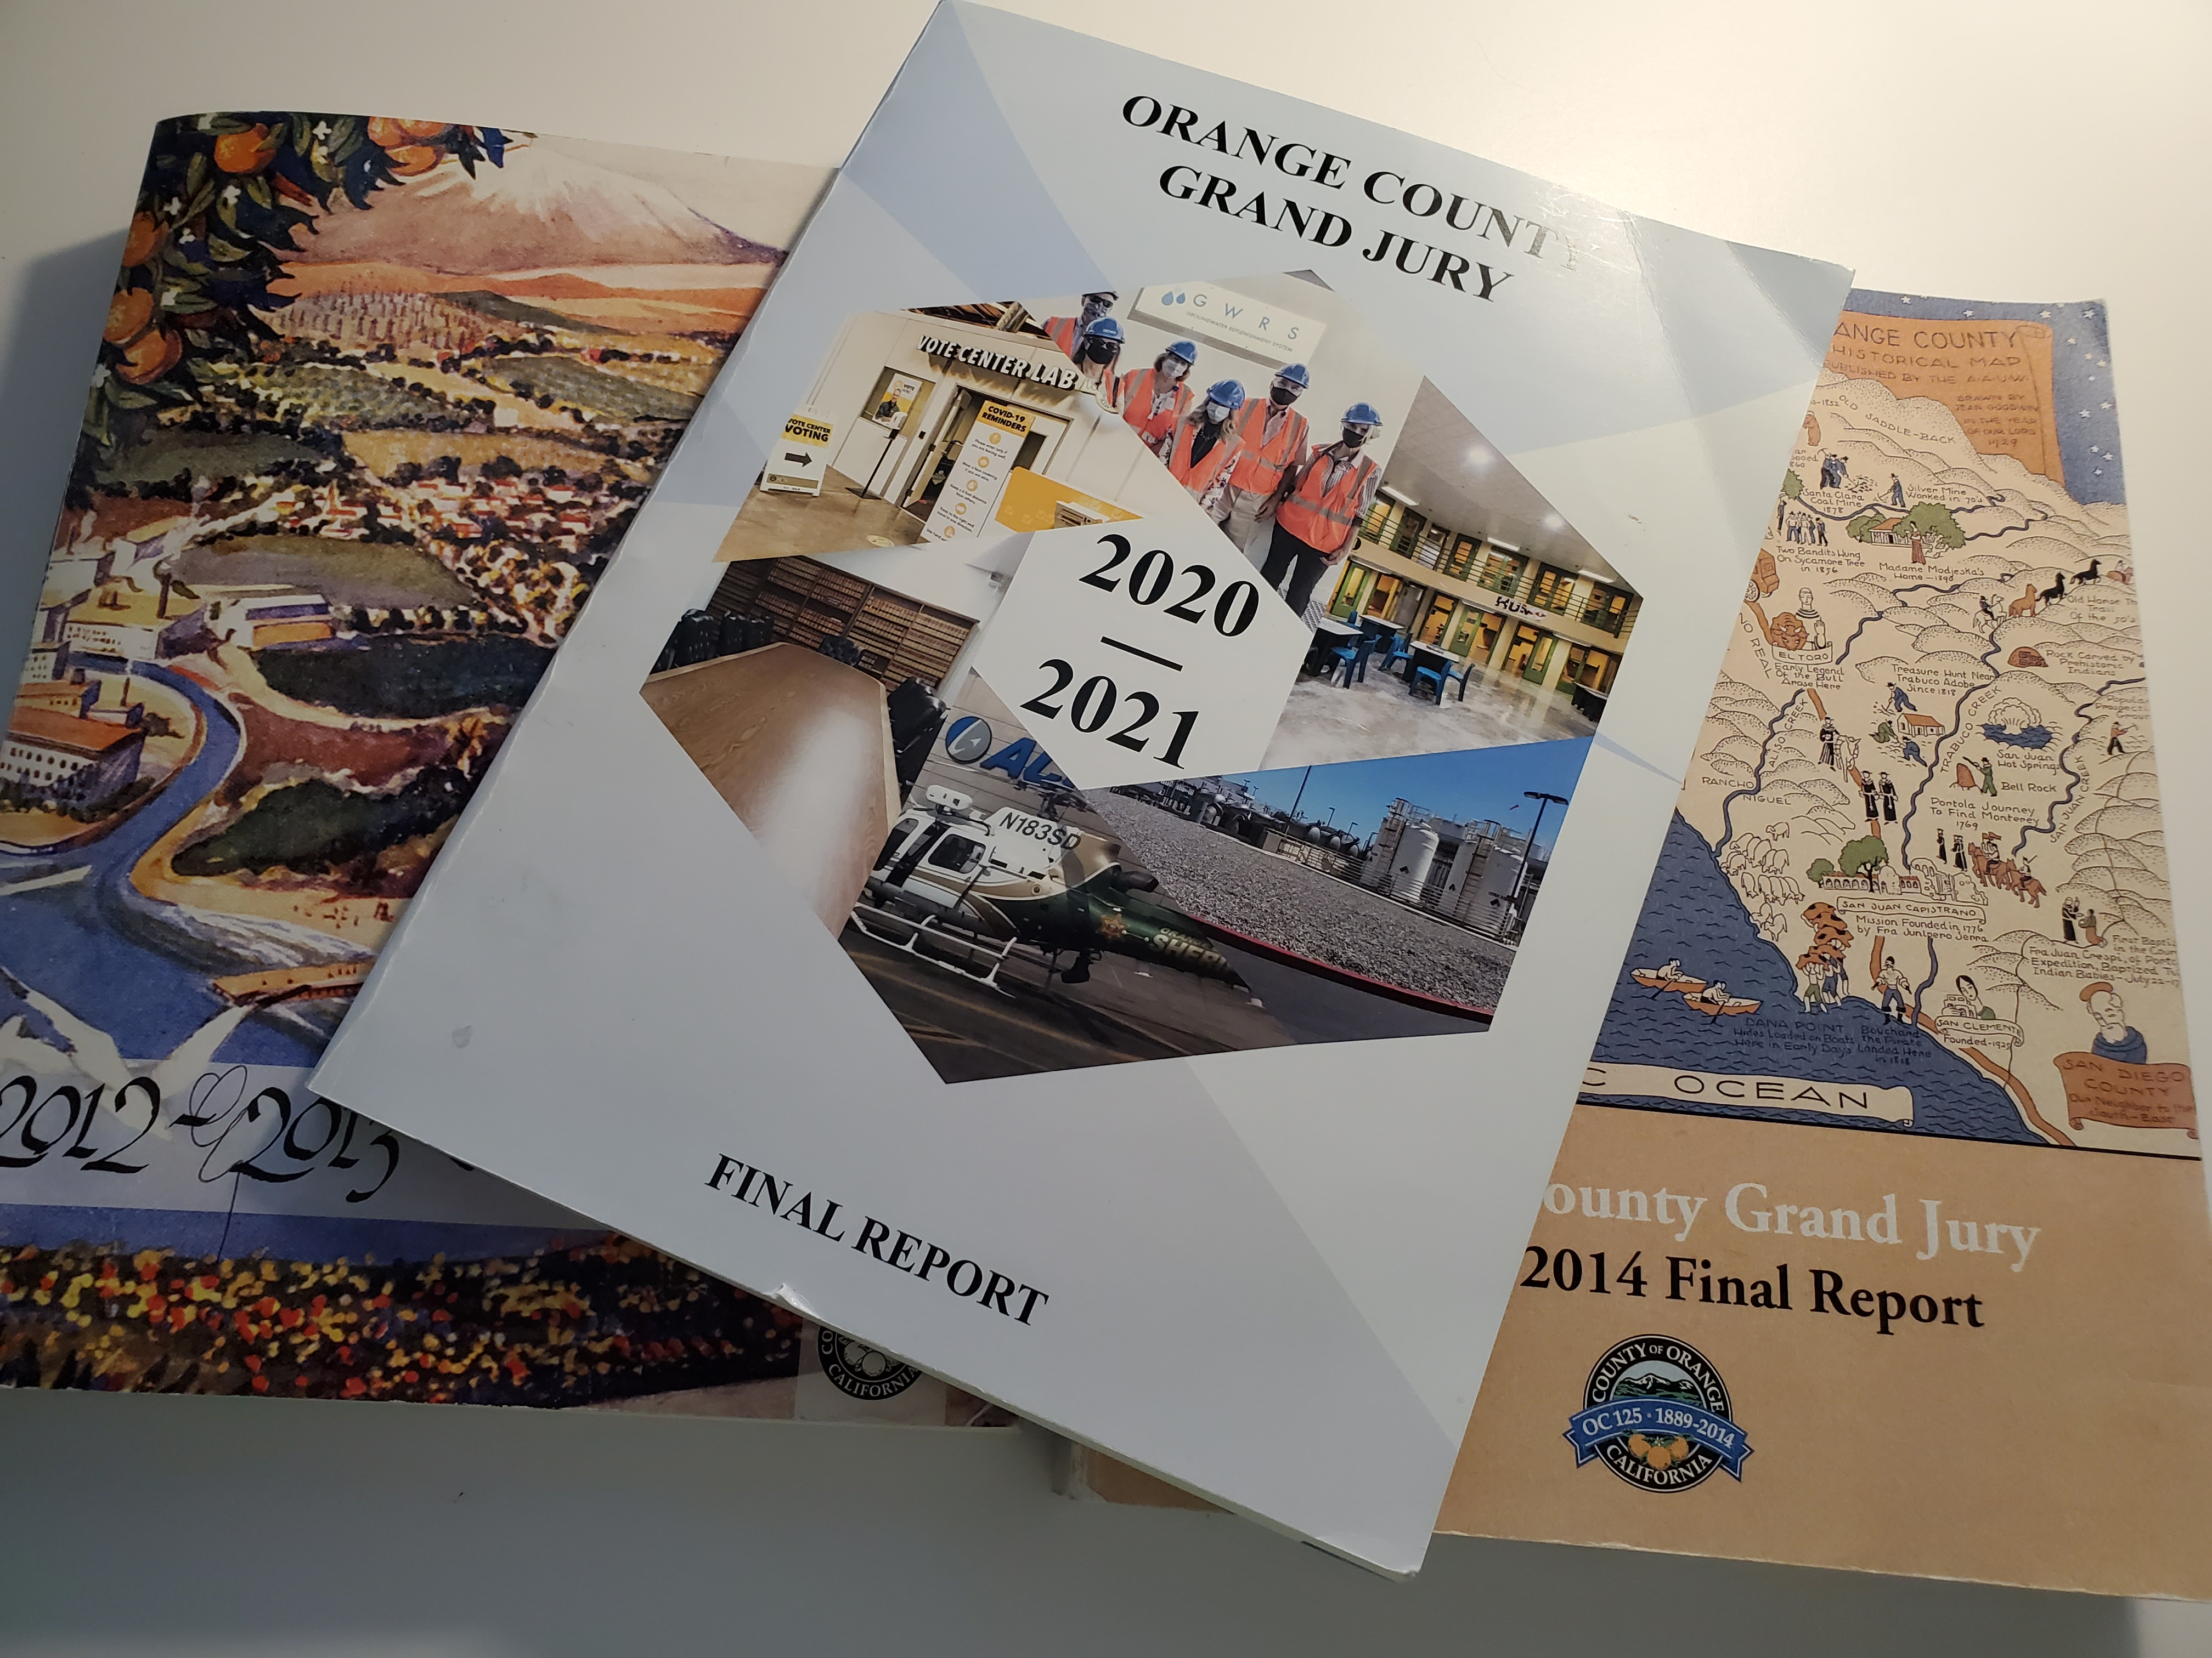
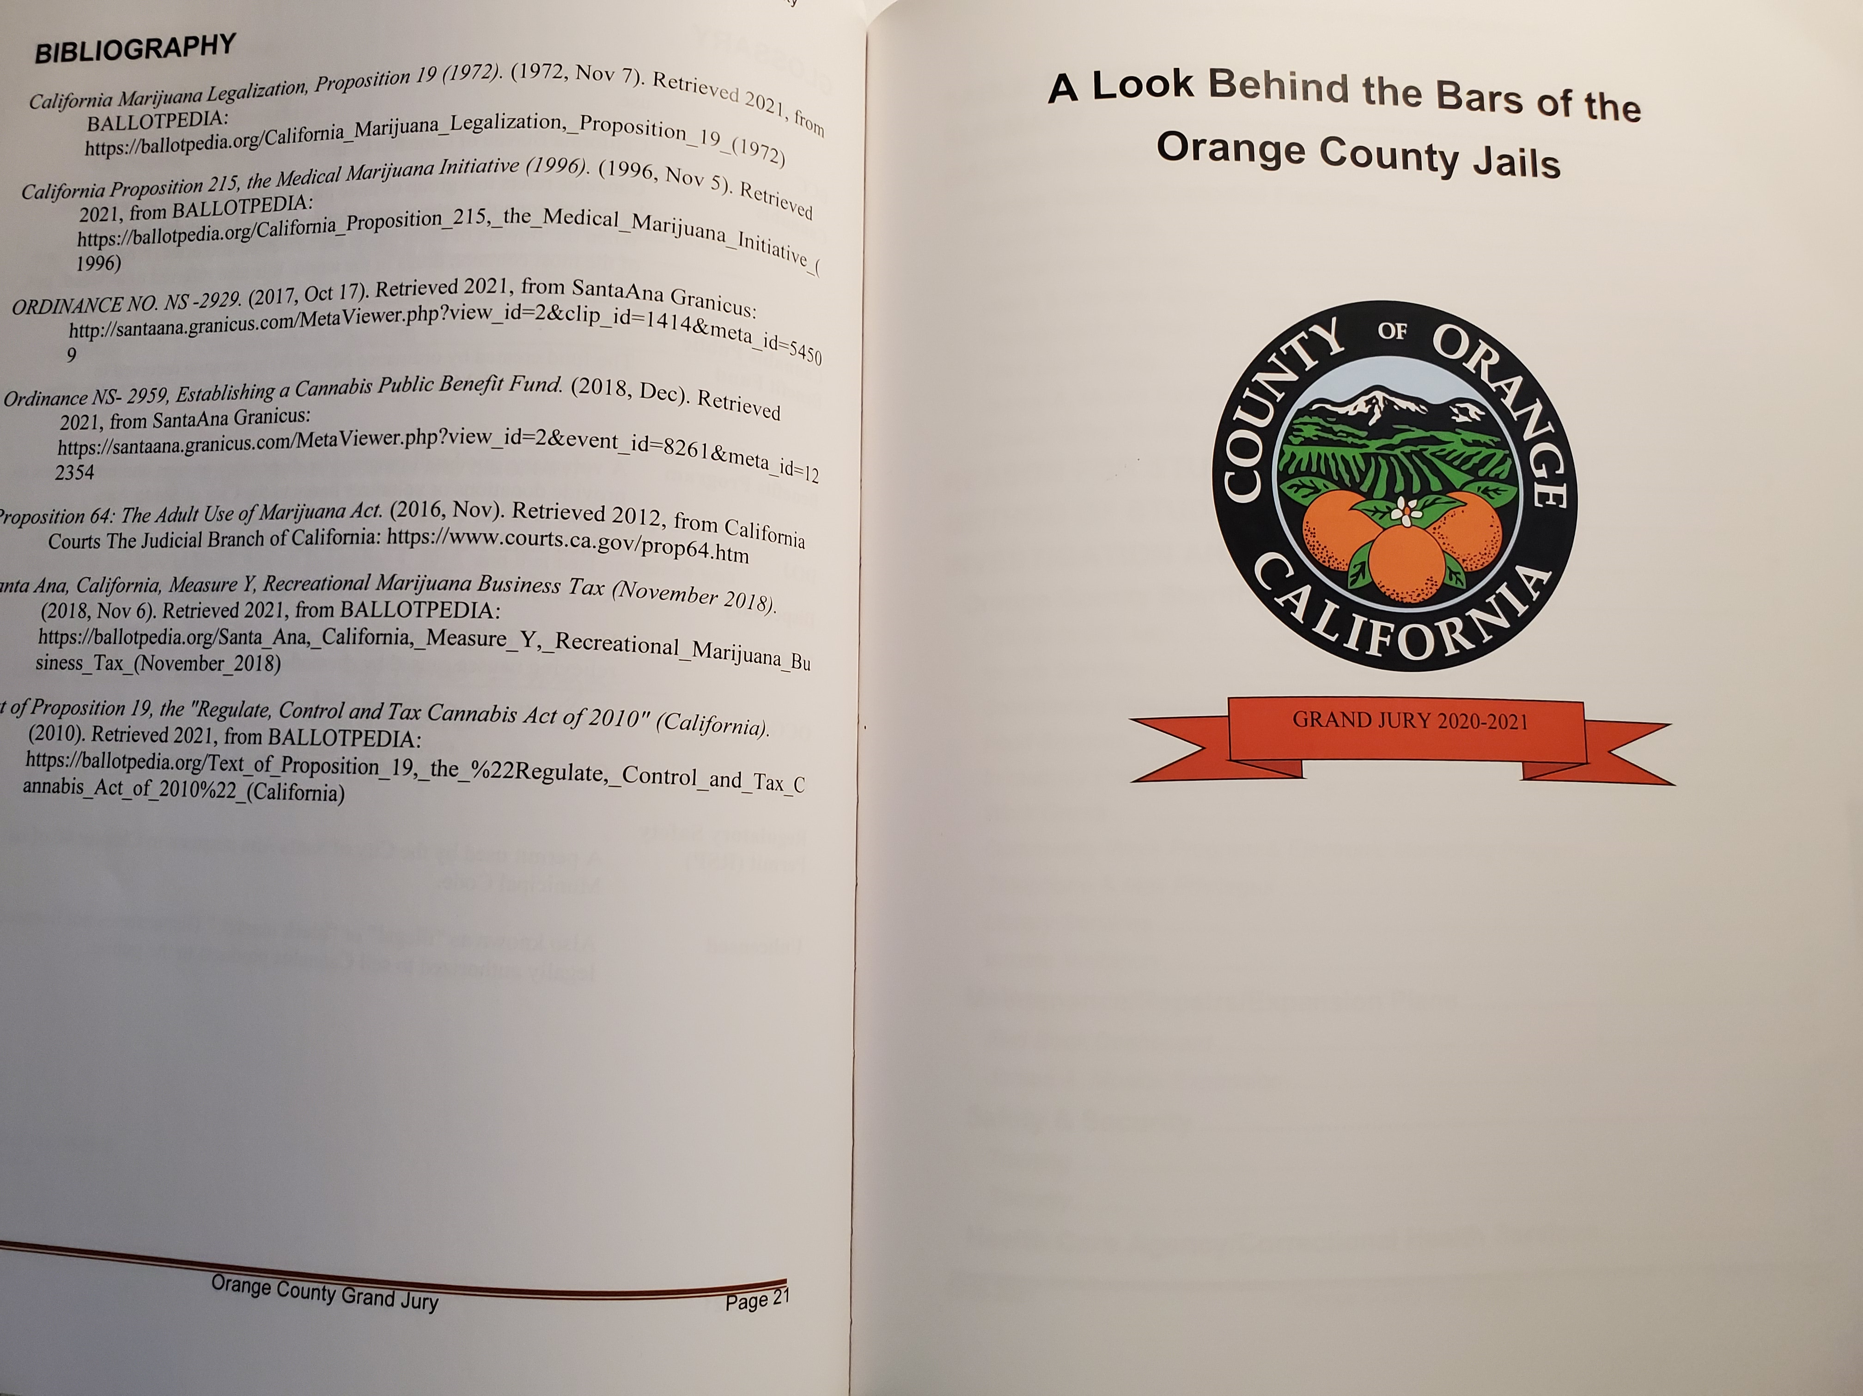
Investigations and Reports
Grand jury is free to choose which governmental entities or public officials to investigate.
Ideas for investigations - citizen complaints, referrals from preceding grand jury, whatever is currently “trending”.
While the Grand Jury has no authority to order or otherwise compel compliance, it is through its reports that the grand jury wields its power.
  Media attention.
  Public pressure often prompts the implementation of the recommended changes.

Slide 10
Responses
The California Penal Code provides requirements to respond to the Findings and Recommendations of the Grand Jury report.
Public agencies must respond within 90 days;
County officer must respond within 60 days.

Slide 11
Findings
Respondent agrees with Finding;
Respondent disagrees wholly or partially with Finding;

Slide 12
Recommendations
The Recommendation has been implemented;
The Recommendation has not yet been implemented but will be implemented in the future… (with a timeframe).
The Recommendation requires further analysis…(not to exceed 6 months);
The Recommendation WILL NOT be implemented because it is not warranted or is not reasonable…(with an explanation therefor).

Slide 13

Grand jury report:
“Orange County animal shelter plagued by deplorable conditions, disease”
https://abc7.com/orange-county-animal-care-ocac-investigations-shelter/795181/

Slide 14
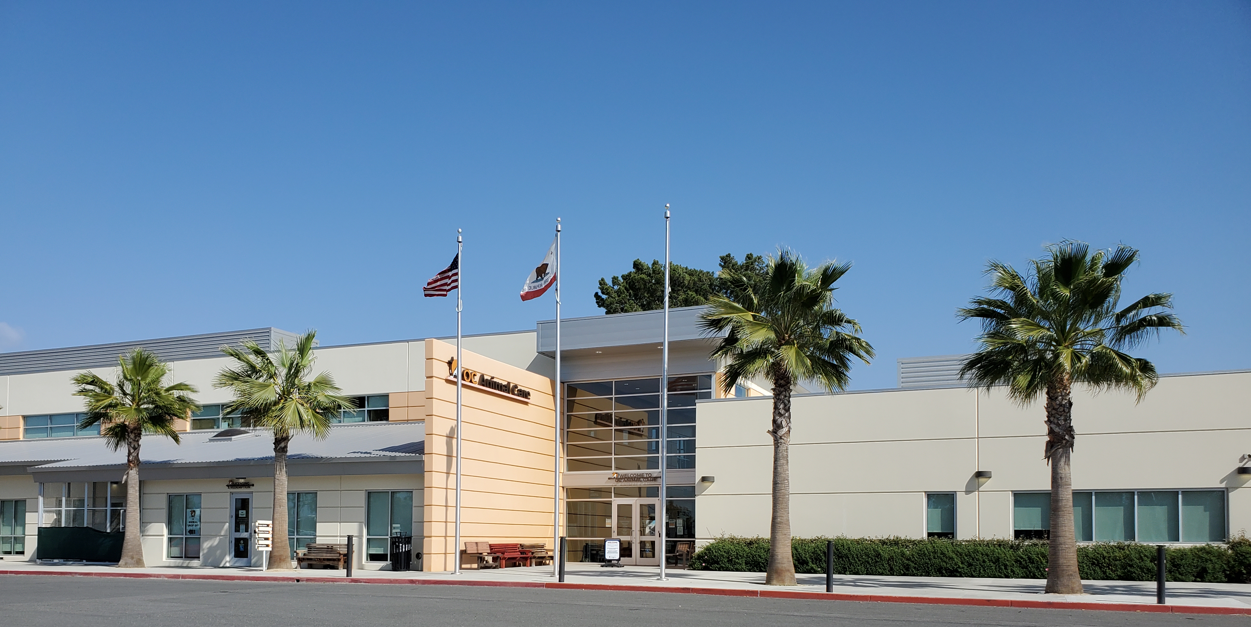
Newly constructed OC Animal Shelter today

Slide 15
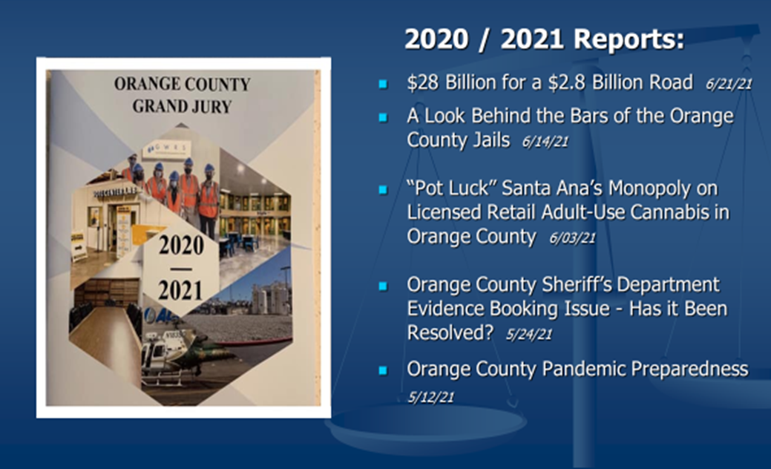
2020 / 2021 Reports

Slide 16
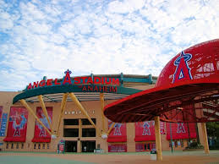

2021 / 22 Reports
OC Grand Jury Says Anaheim 'Betrayed' By Angel Stadium Deal: Report
Patch Staff
Grand jury slams O.C. Power Authority’s inexperienced leadership, lack of transparency
Times OC

Slide 17




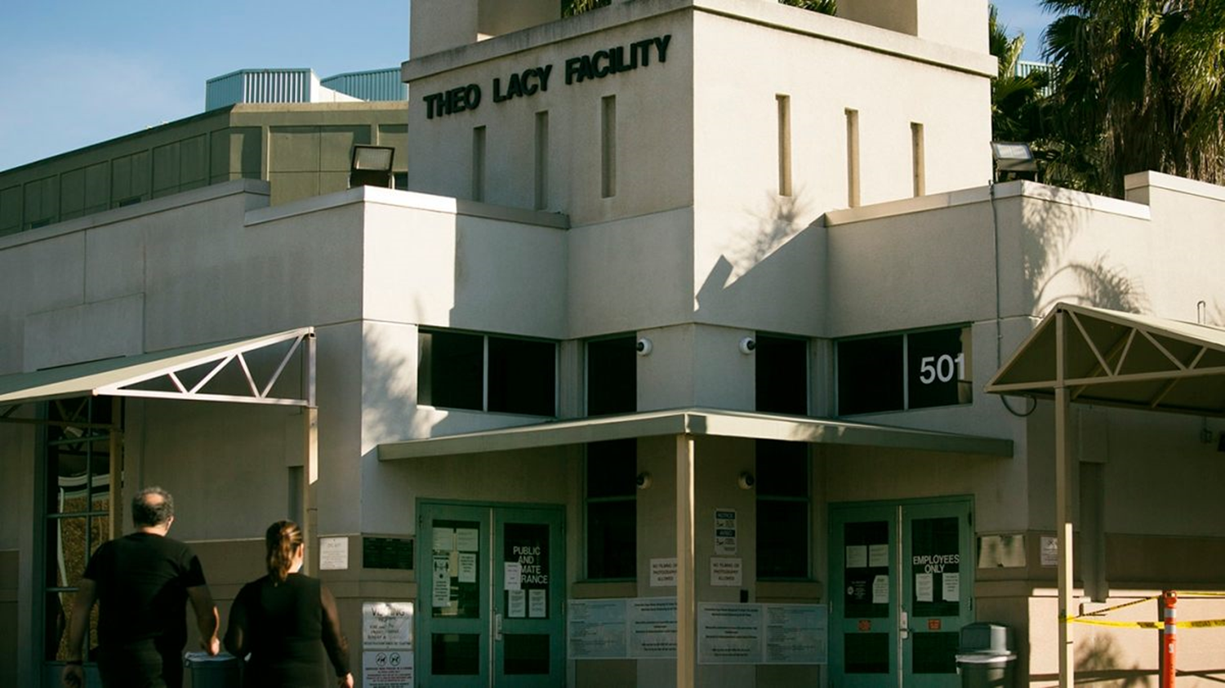
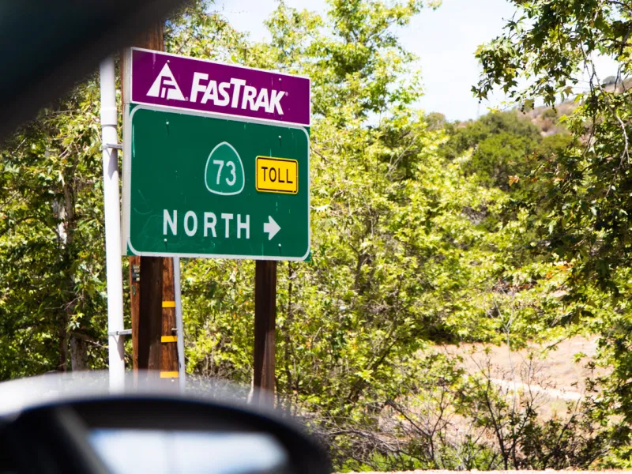

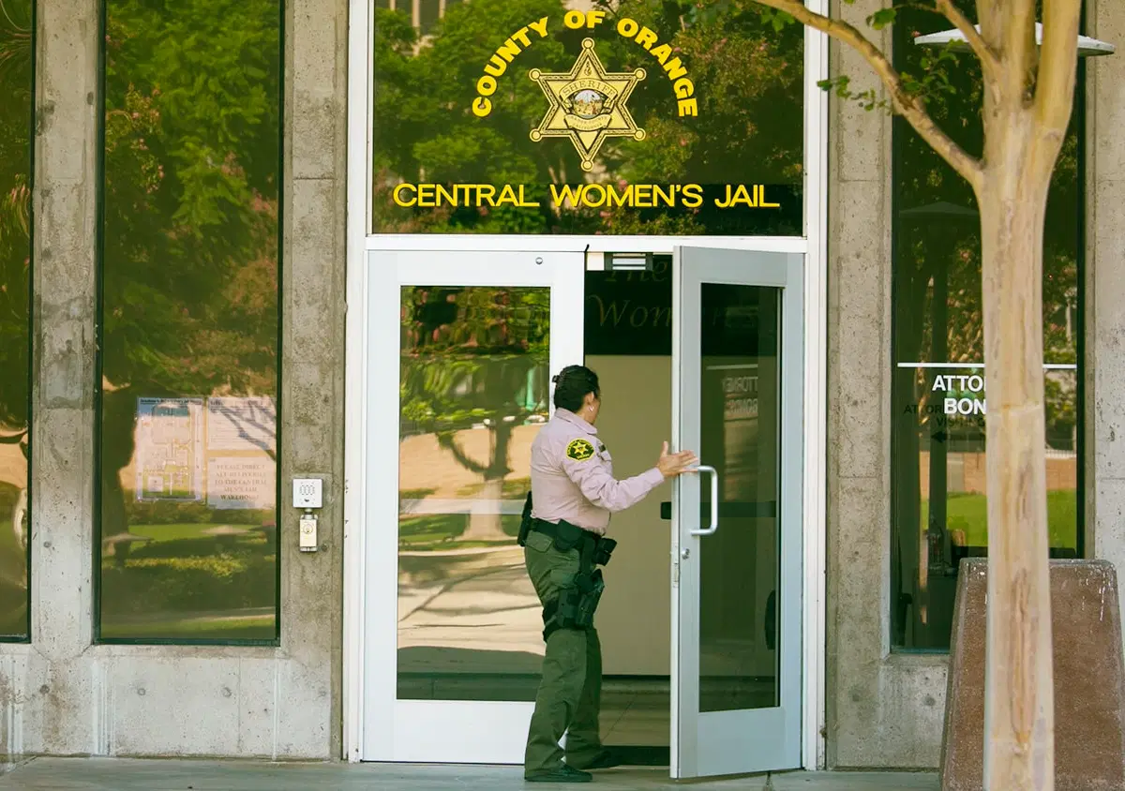
Newspaper
Reporting
Despite High-Profile Escape, OC Jails Still Have Major Security Risks, Grand Jury Finds
OC Grand Jury Issues Report on County’s Pandemic Response, Plans
OC grand jury slams sheriff’s failure to lead
In Scathing Report, OC Grand Jury Describes Shackles During Birthing, Care Delays in Custody
Grand jury report critical of toll roads
Deputy’s False Police Report Charge Came After Mountain of Testimony to Grand Jury

Slide 18
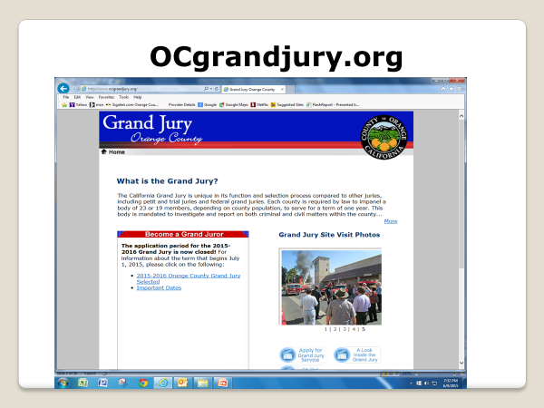
OCGRANDJURY.ORG
.

Slide 19
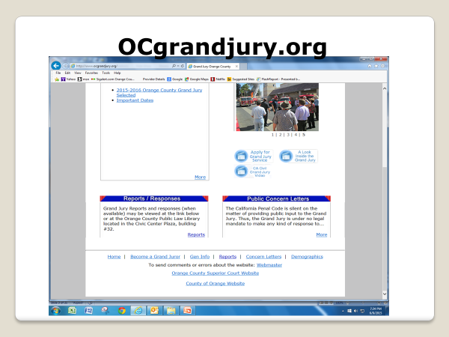

Slide 20

Grand Jury Reports
All Grand Jury Reports are in Adobe Acrobat (.pdf) format. Click here to download Acrobat Reader.
Grand Jury Reports and responses (when available) may be viewed at the links below or at the Orange County Public Law Library located in the Civic Center Plaza, building #32.
Expand All / Collapse All
2020-2021 Reports, in order of release.
2019-2020 Reports, in order of release.
2018-2019 Reports, in order of release.
2017-2018 Reports, in order of release.
2016-2017 Reports, in order of release.
2015-2016 Reports, in order of release.
2014-2015 Reports, in order of release.
2013-2014 Reports, in order of release.
2012-2013 Reports, in order of release.
2011-2012 Reports, in order of release.
2010-2011 Reports, in order of release.
2009-2010 Reports, in order of release.
2008-2009 Reports, in order of release.
2007-2008 Reports, in order of release.

Slide 21
2019-2020 Reports, in order of release.
2019-2020 Grand Jury Final Report 07/30/20
Status Update on open 2019-2021 Grand Jury Implementation Items 03/23/21
OC Recycling: Doing it the Right Way 06/30/20
  City of Santa Ana 12/14/20
  City of Irvine 11/24/20
  City of Orange 11/06/20
  City of Brea 11/05/20
  City of Huntington Beach 10/07/20
  City of Buena Park 09/23/20
  City of Dana Point 09/10/20
  City of Anaheim 09/02/20
  City of Anaheim 08/26/20
  County of Orange Executive Officer 08/25/20
  City of Garden Grove 08/25/20

Slide 22
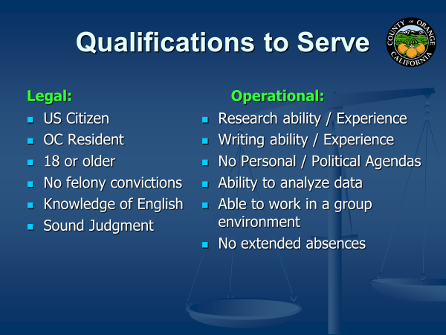

Slide 23

Organization of the Grand Jury
  1 Year Term – July 1 to June 30
  Members:
    Applications rec’d 100 - 200
    Applications vetted 90
    Final Selection 30 applicants
    Seated 19
    Alternates 11
  Working Hours:
    Mon-Thurs 8:30 – 3:30
    Fridays 8:30 – Noon
  Stipend of $50/day; + Mileage
  Officers:
    Foreperson (selected by Judges)
    Foreperson Pro-Tem
    Secretary
    Assistant Secretary
    Sergeant at Arms
    Historian / Parliamentarian
Committees:
Criminal Justice
Cities / Counties
Transportation & Environmental
Social Services / Human Services
Continuity / Special Issues
Recruitment & Orientation
Editorial

Slide 24
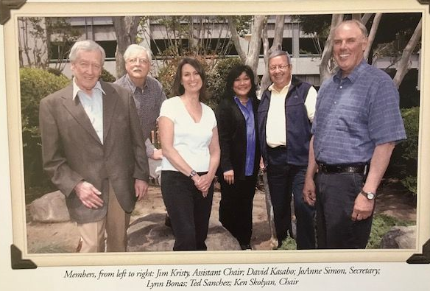
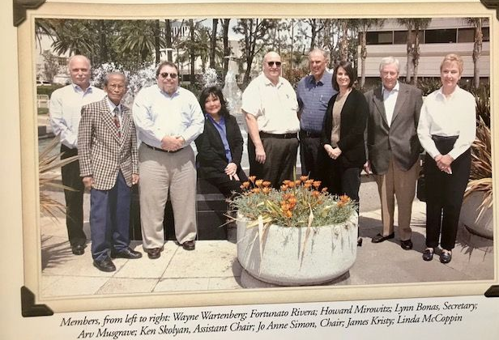
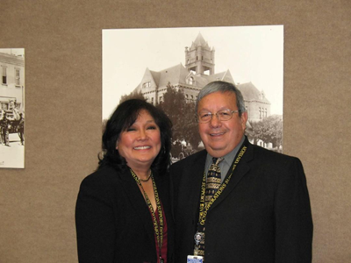
Friends for life . . . .
Editorial Committee
Environmental & Transportation Committee

Slide 25
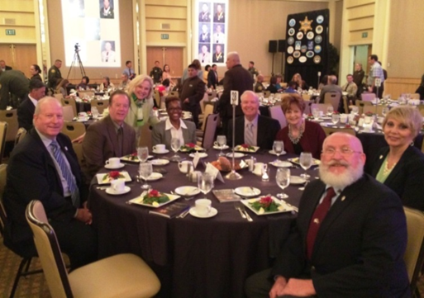
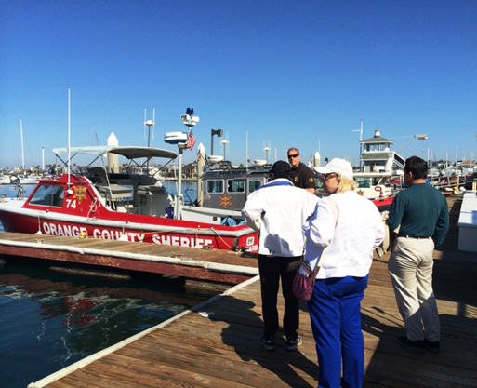
Friends for life. . .
Touring Newport Harbor
Medal of Valor Luncheon

Slide 26

Judge Maria Hernandez
Assistant Presiding Judge

Slide 27




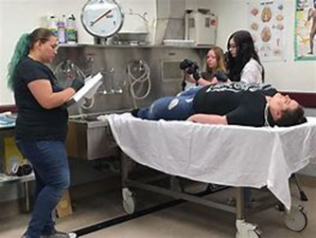

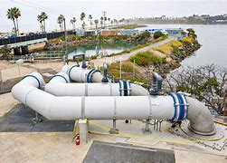



Orange County Tours and Visits
911 Emergency Call Center
OC Water District
Coroner’s
MWD
Shooting Range
JWA Airport
County offices
Court House

Slide 28
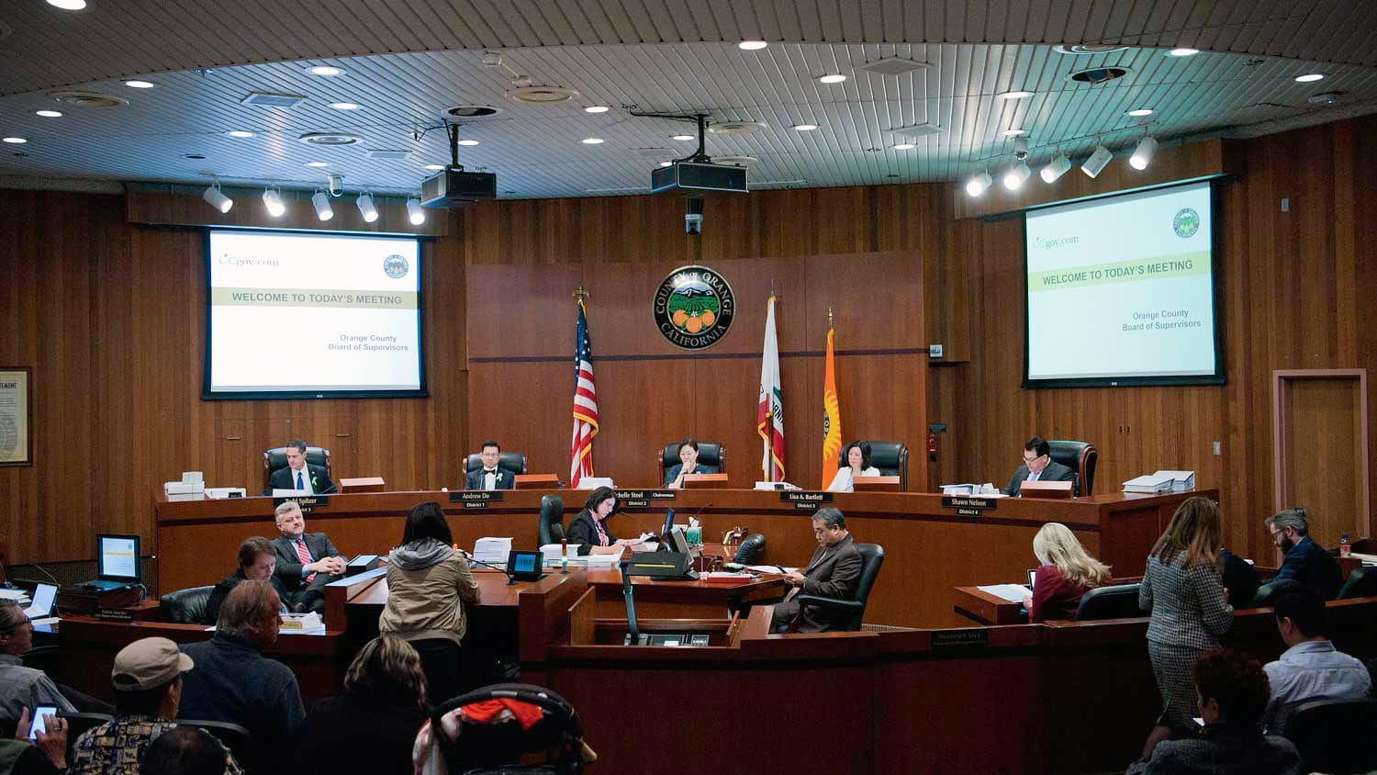


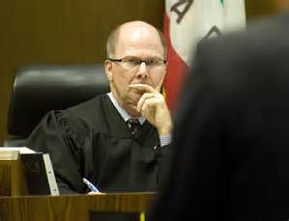
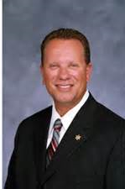
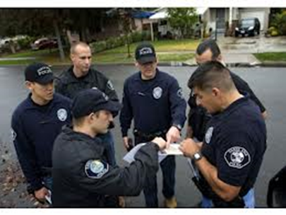
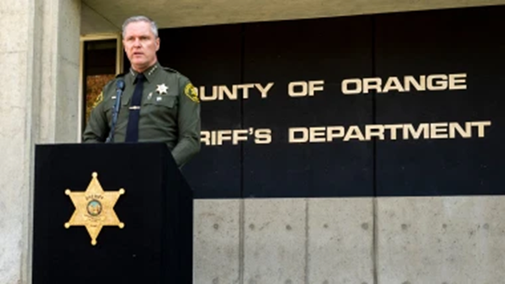

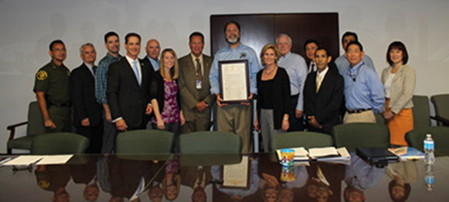

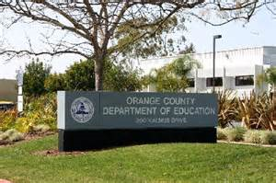

County Departments
Board of Supervisors
Elected Officials & Judges
Sheriff’s Dept.
OC Animal Care
OC Dept. of Education
Health Dept.
Orange County Criminal Justice Coordinating Council

Slide 29


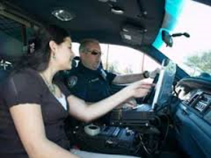
Ride-Alongs with OC Sheriff
(Patrol Car, Harbor Boats, Equestrian, Helicopter)

Slide 30
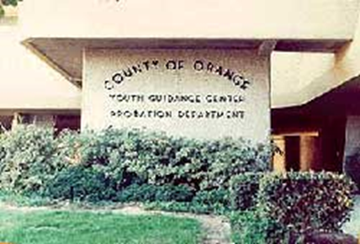
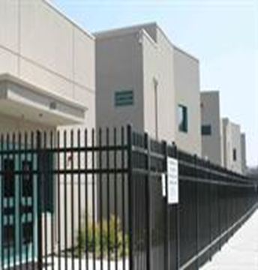

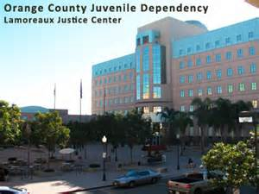
Juvenile Facilities
Youth Guidance Center
Youth Leadership Academy
Juvenile Hall

Slide 31

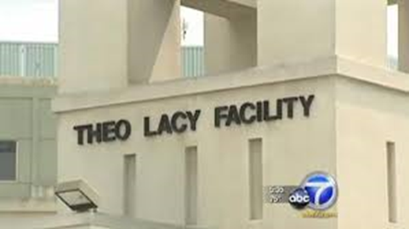
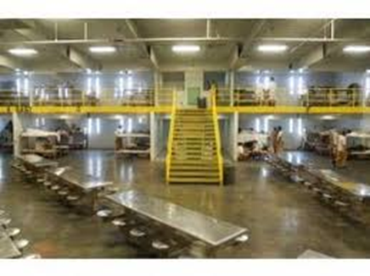
Central Jail, Theo Lacy Jail, Musick Jail

Slide 32

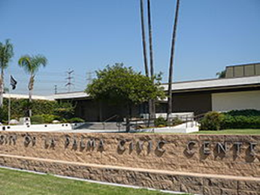


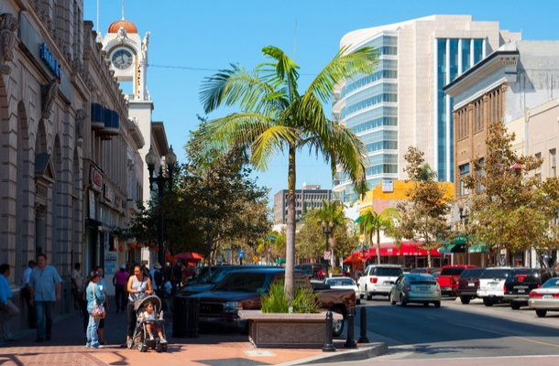


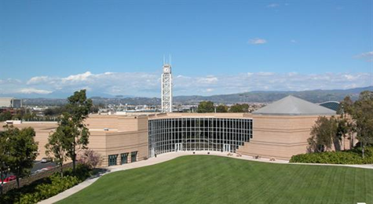
Cities
City Council Meetings
Great Park in Irvine
Dana Point Harbor
Downtown Santa Ana
Huntington Beach
Irvine City Hall

Slide 33
Orange County Grand Jury
QUESTIONS
AND
ANSWERS
www.ocgrandjury.org

