Slide 1
orange county
Grand Jury

Slide 2
Do you like to read ?

Slide 3
World News
Do you watch TV ?

Slide 4
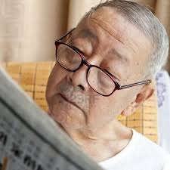
Do you like to keep up with
what’s happening ?

Slide 5
Do you like to figure things out ?

Slide 6
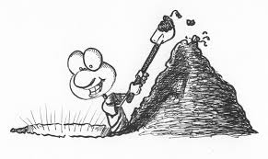
Do you like to dig into things
and find answers ?

Slide 7
The Grand Jury
Apply to serve on the County’s civil watchdog panel!

Slide 8
The Grand Jury
This may be good for
You
A family member
A friend

Slide 9
The Grand Jury
Not necessarily what you think we are…

Slide 10
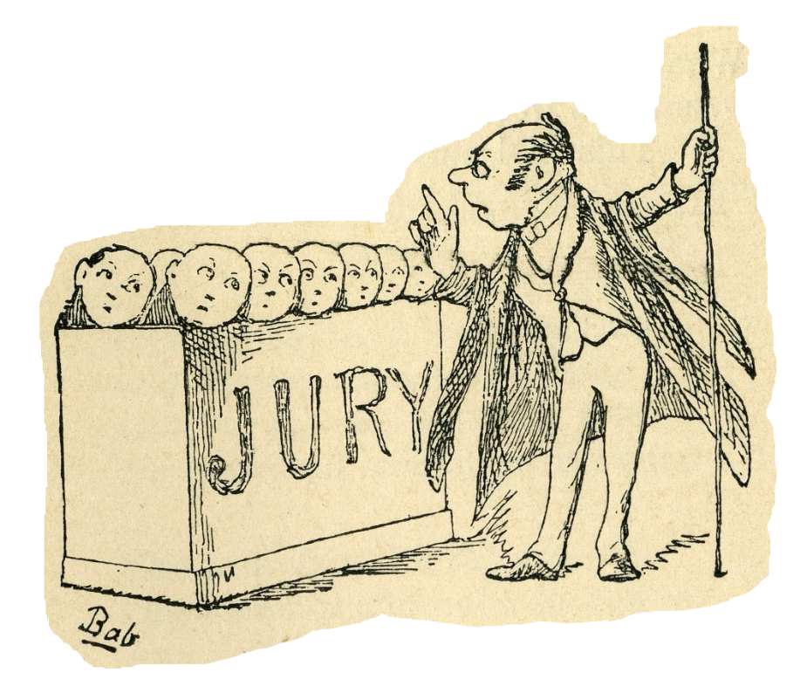
The Grand Jury
We are not a trial jury.

Slide 11
The Grand Jury
We hear criminal indictment and evidentiary hearings presented by the District Attorney, but …

Slide 12
The Grand Jury
…we actually spend most of our time investigating local government agencies.

Slide 13
The Grand Jury
We verify that local tax dollars are spent wisely.

Slide 14
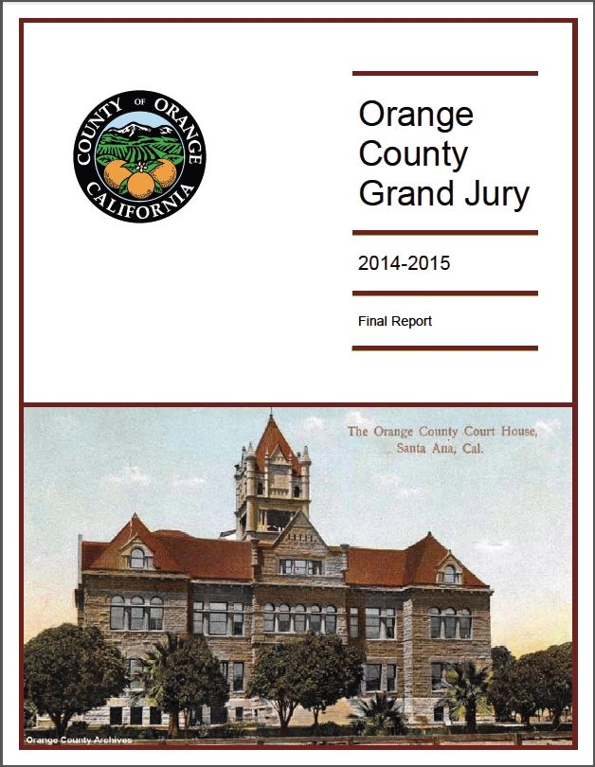
The Grand Jury
We issue public reports with recommendations for government agency improvements.

Slide 15
The Grand Jury
By law, government agencies must respond to our recommendations for improvement.

Slide 16
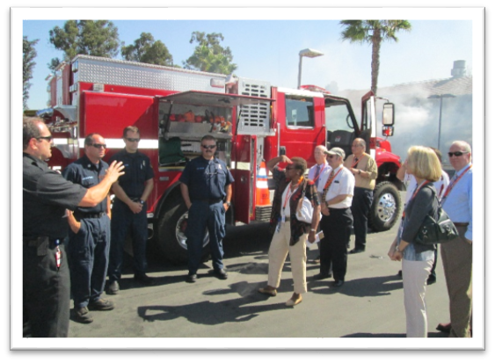
Qualifications to Serve
The Grand Jury
18 years of age or older
U.S. citizen
Orange County resident
No felony convictions
Knowledge of English
Sound judgment

Slide 17
Things we do
The Grand Jury
Investigate
Research
Analyze
Write
Work in teams

Slide 18
Benefits
The Grand Jury
Meet county leaders
Learn how local government works
Have an experience of a lifetime
Leave a legacy

Slide 19
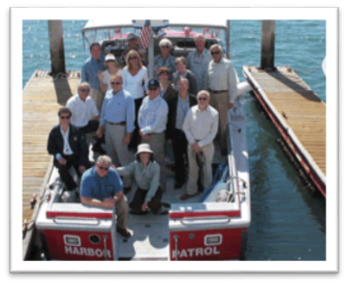
FYI
The Grand Jury
Full-time commitment for one year
$50 per day stipend plus mileage
Grand Jury sets work schedule
Some field work
Secure underground parking

Slide 20
The Grand Jury
To apply for the O.C. Grand Jury,
go to www.ocgrandjury.org
or call 657-622-6747

Slide 21
The Grand Jury
19 members working together to improve Orange County.

Slide 22
The orange county Grand Jury
Make a Difference!
Act as watchdog on local government
Insure local tax dollars are spent wisely
Recommend local government reforms
Deliberate in criminal indictment hearings
Apply to serve on the
2018-2019 Orange County Grand Jury!
www.ocgrandjury.org or 657-622-6747

